Slide 2
Our Mission: To improve the lives of millions of women worldwide who suffer from urinary incontinence, prolapse or pelvic pain.

Slide 4
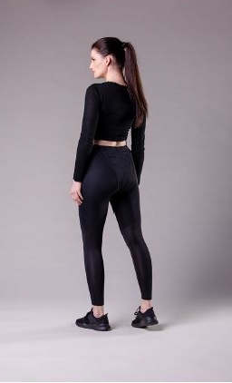
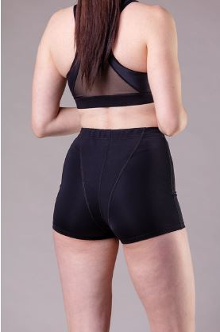
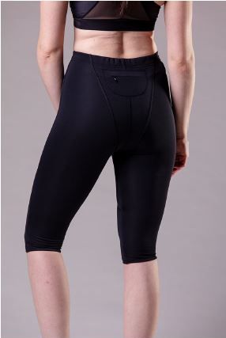
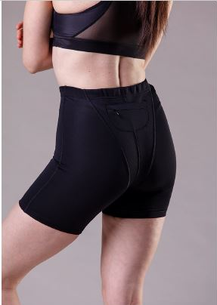
Technology = Type of Materials Chosen
Mimic pelvic floor muscles
Layered ergonomically to provide optimum support.
Softness
Rigidness
Flexibility
Durability
Boxer Briefs
Capris
Shorts
Leggings

Slide 5
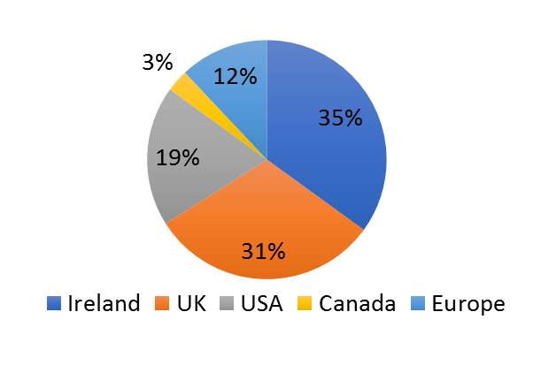
Over 22,000 units sold across 40 countries in 5 continents
84% Excellent
10% Great

Slide 6
Why we do what we do?
The Difference between a good and a bad day!
“Following many problems with mesh implant
and removal, followed by incisional hernias
and bladder prolapse I have been on a quest
to try and avoid further surgery. My pelvic
physio recommended EVB to me. At first I was a
little sceptical but I can honestly say that for me
wearing the sports shorts is the difference between
a good and a bad day. They are very supportive,
enabling me to carry out daily activities and light
exercise by reducing the feeling of pelvic pressure and
fullness. I am truly grateful to EVB for helping me to fee
l more comfortable and live a more vertical life!”
Jacqueline Oxley Dec 2020

Slide 7
Transformative
“EVB boxer briefs have transformed my ability to exercise and also day to day activities. When I have them on I feel like I have a functioning pelvic floor, so supportive and comfortable, I actually forget! Yvonne is more than the founder/inventor, her personalised service is so unique & she offers much more than just a product, with her useful resources and information. It doesn’t feel like such a lonely problem when you are aware of the supports available. I wouldn’t be keen on surgery, & evb is such an effective alternative.”
Dr. Louise Fitzgerald 26 Nov 2020

Slide 8
info@evbsport.com
@evbsport
@evbsport

