Slide 1
Let’s talk about sex after perineal trauma
Kate Walsh & Emma Mathews

Slide 2
Consequences?
Genito – pelvic pain/penetration disorder
Anxiety and depression
OCD (obsessive cleaning and checking if AI)
PTSD
Relationship problems
Social isolation
Body image issues

Slide 3
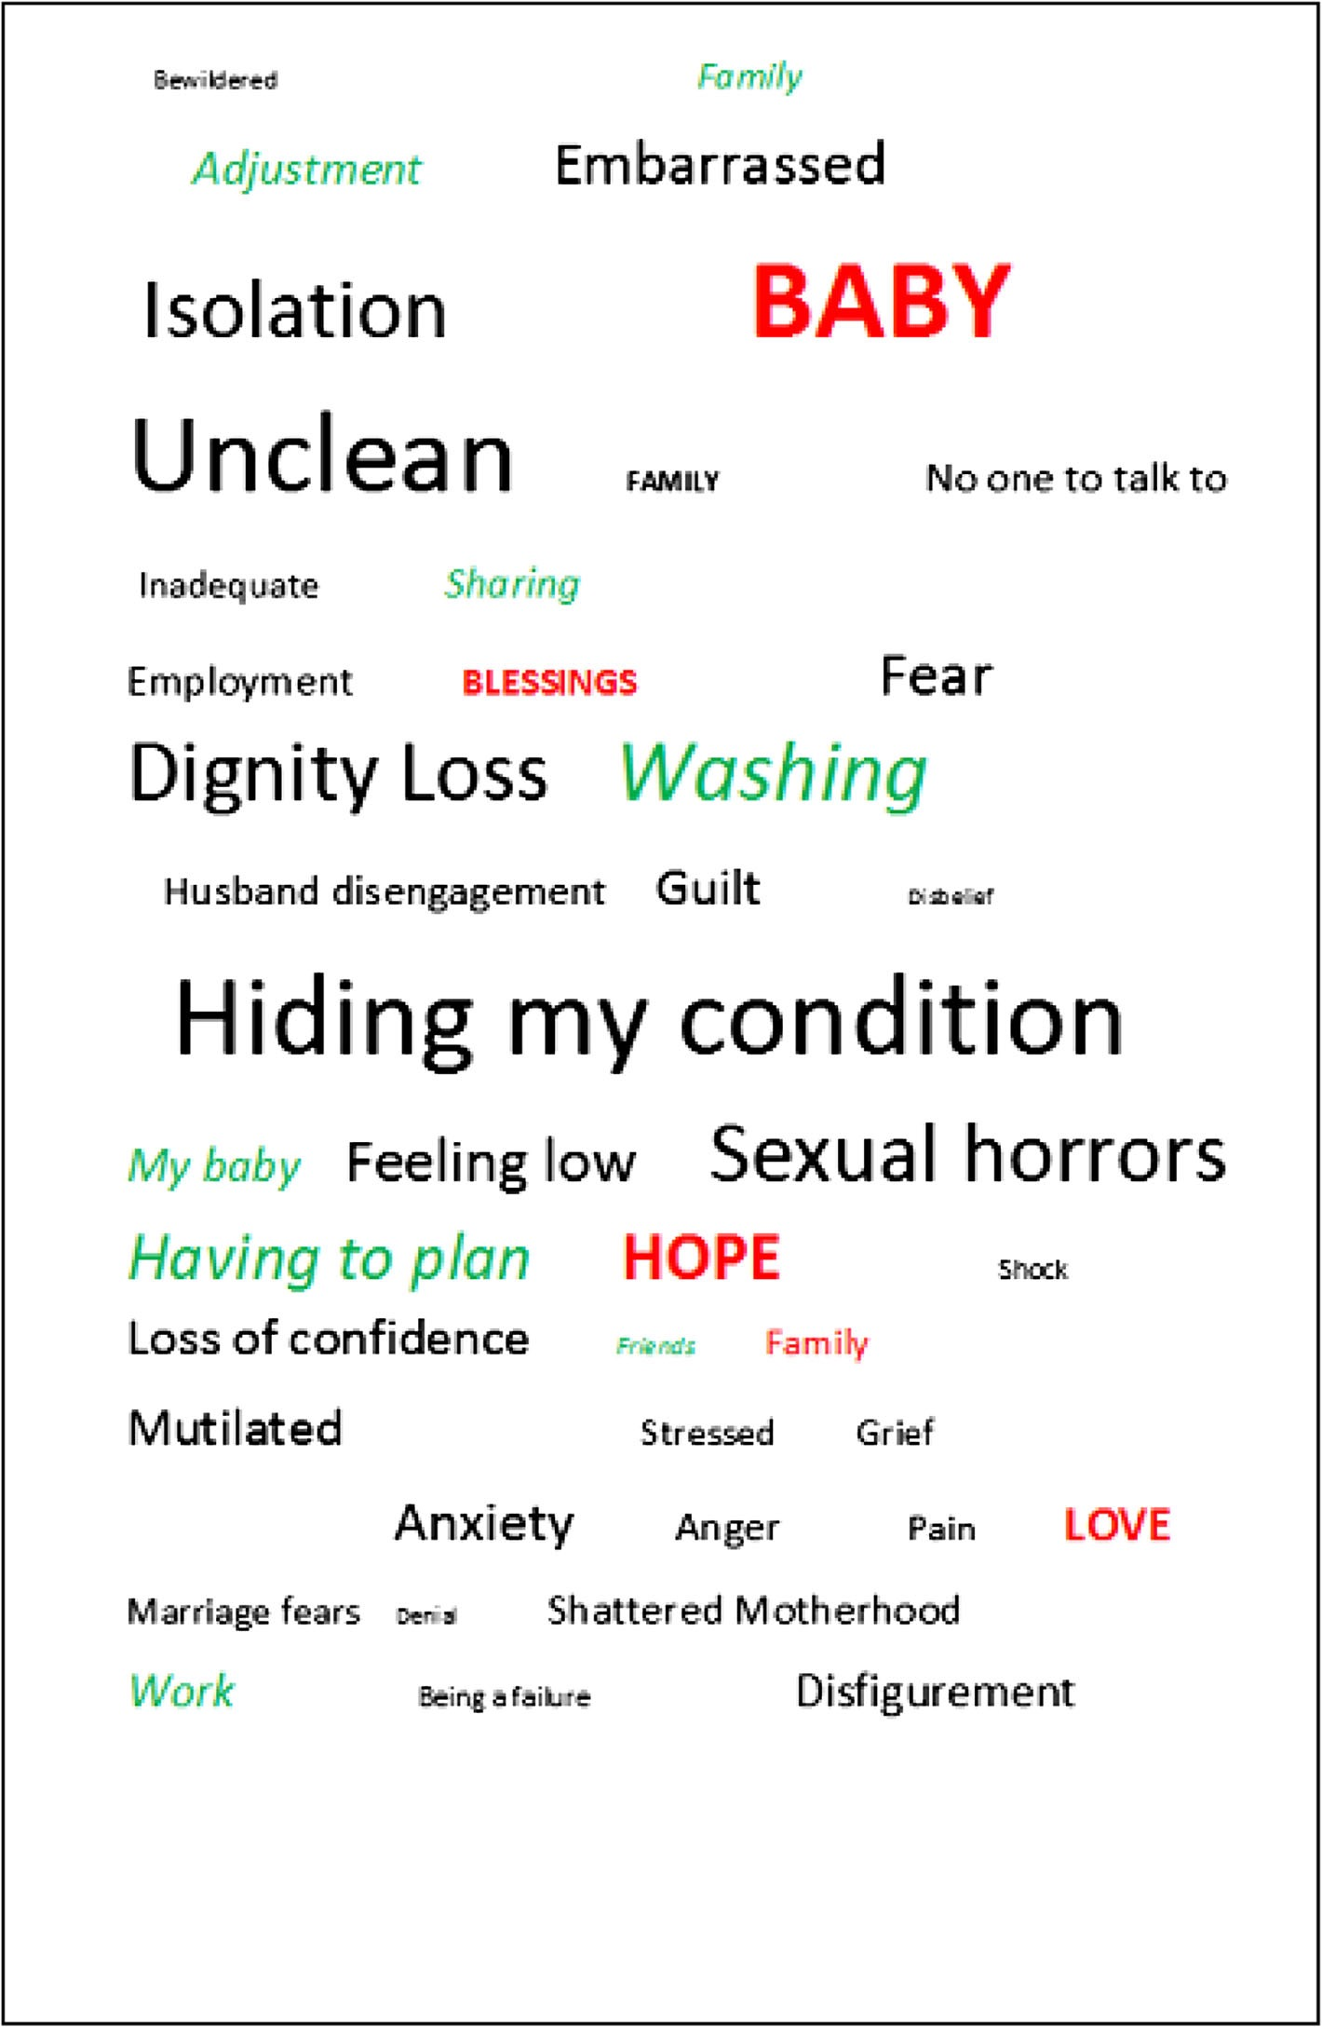
The social, psychological, emotional morbidity and adjustment techniques for women with anal incontinence following Obstetric Anal Sphincter Injury: use of a word picture to identify a hidden syndrome Keighley et al. BMC Pregnancy and Childbirth (2016) 16:275 DOI 10.1186/s12884-016-1065-y

Slide 4
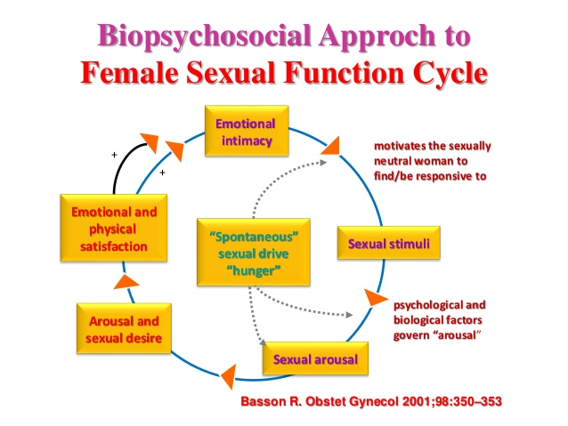

Slide 5
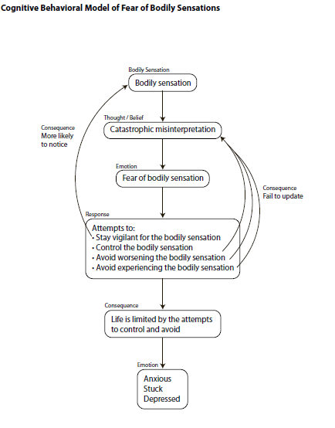
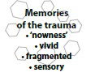
e.g. around vulva/vagina
e.g. “ I’ll be in agony, I’ll be out of control, I’ll lose control of my bowels, I’ll be embarrassed, my partner will leave me, I’ll never be able to have sex again, I’m not normal, I’m damaged etc.”
Vaginal muscles contract
Avoid any genital contact, cervical smears, tampon use, etc. various safety behaviours

Slide 6
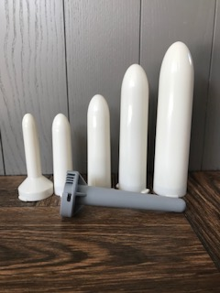
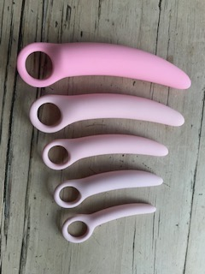
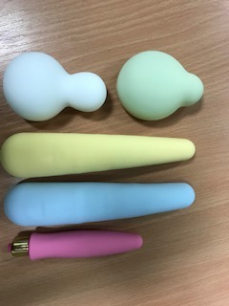
Behavioural homework tasks
Solo tasks - graded exposure using vaginal dilators
Partnered tasks – graded exposure with sensate focus exercises

Slide 7
Other interventions
Cognitive restructuring
Compassion focused therapy
Trauma focused therapy - TFCBT, EMDR

Slide 8
Dyspareunia
Persistent, recurrent, urogenital pain occurring before/during/after sexual intercourse
Notes:
Deleted dyspareunia/vaginissimus

Slide 9
Statistics
Population prevalence 3-18% globally
(Harlow 2014)
Most common age range
55 - 64 years – 10.4%
16 – 24 years – 9.5%
75% sexually active women 16-74 yrs
(Lee & Jakes 2018)

Slide 10
MISDIAGNOSED
MISMANAGED
TRIVIALISED
NEGLECTED
IGNORED
Notes:
This can exacerbate symptoms great personal cost to patient and financial cost to society

Slide 11
CAUSES
PHYSICAL
PSYCHOLOGICAL
DEEP – within the pelvis
SUPERFICIAL – vulval pain
ONSET –sudden/gradual
Notes:
Challenge is created by the complex interplay between both -> hard to identify the cause
Deep/superficial can undermine attempts to treat pain experience holistically gynae subspecialities manage various causes -> compartmentalisation with little cross over

Slide 12
Pelvic floor (PF) related sexual dysfunction
Role of PF crucial
57% women with overactive PF report dyspareunia secondary to:-
Stretch of shortened PF muscles
Stimulation of painful region and/or local adhesions
Organ dysfunction
Notes:
Vaginissimus/CPP/dyspareunia pain can last 3 days following sex. Impact QOL/relationship

Slide 13
Physiological changes at PF level
Repeated/prolonged somatic and/or visceral sensory input of nociceptors
Decreased activation threshold -> sensitisation of previously “non-involved” afferent nerve fibres – PERIPHERAL SENSITISATION
Notes:
Pain perception. Initially functionally “silent” fibres activated after being sensitised by excitatory stim.

Slide 14
Physiological changes contd.
CENTRAL SENSITISATION
Afferent bombardment of noxious stimuli via viscero-somatic convergence in dorsal horn
Brain perceives intense pain
Allodynia
Hyperalgesia
Notes:
And ongoing somatosensorial input from muscle and skin. Amplification and perpetuation of pain perception.

Slide 15
Physiological changes contd.
Convergence of neural info hinders precise localisation and discrimination of sensory info
Upregulation of sensory system -> segmental overactivity-> PF spasm/shortening
Notes:
Basis of referred pain and why visceral pathologies felt as pain in somatic structures partic PFM

Slide 16
How can we help?
Multidisciplinary approach
Biopsychosocial model vs Biomedical model
Psychosexual counselling + pelvic floor rehab in addition to usual medical care

Slide 17
Assessment
Explore the pain
Physical/emotional origin
Onset- sudden/gradual/triggers/specific to situation or partner/generalised
Bladder and bowel function
Posture/movement
Breathing
Vulvo-vaginal assessment

Slide 18
What are we looking for?
Tension/resistance
Quality of tissues /muscle/fascia
Gaps
Response to palpation/pressure
Pain /behaviour/local/referred/type
Shortened/lengthened muscle
Active ROM/stiffness
Compensation

Slide 19
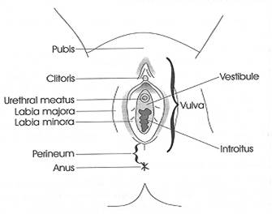
Vulva and Perineum
z

Slide 20
Treatment-where to start?
Education/Advice
Lifestyle
Breathing
Relaxation
Movement
Stretches – adductors/ hamstrings/piriformis
Perineal massage
Abdominal visceral release
Down train/release pelvic floor
Functional exercise

